Slide 1

EXCEL – FINAL ASSESSMENT
KEERTHANAA ARTHANAREESWARAN

Slide 2
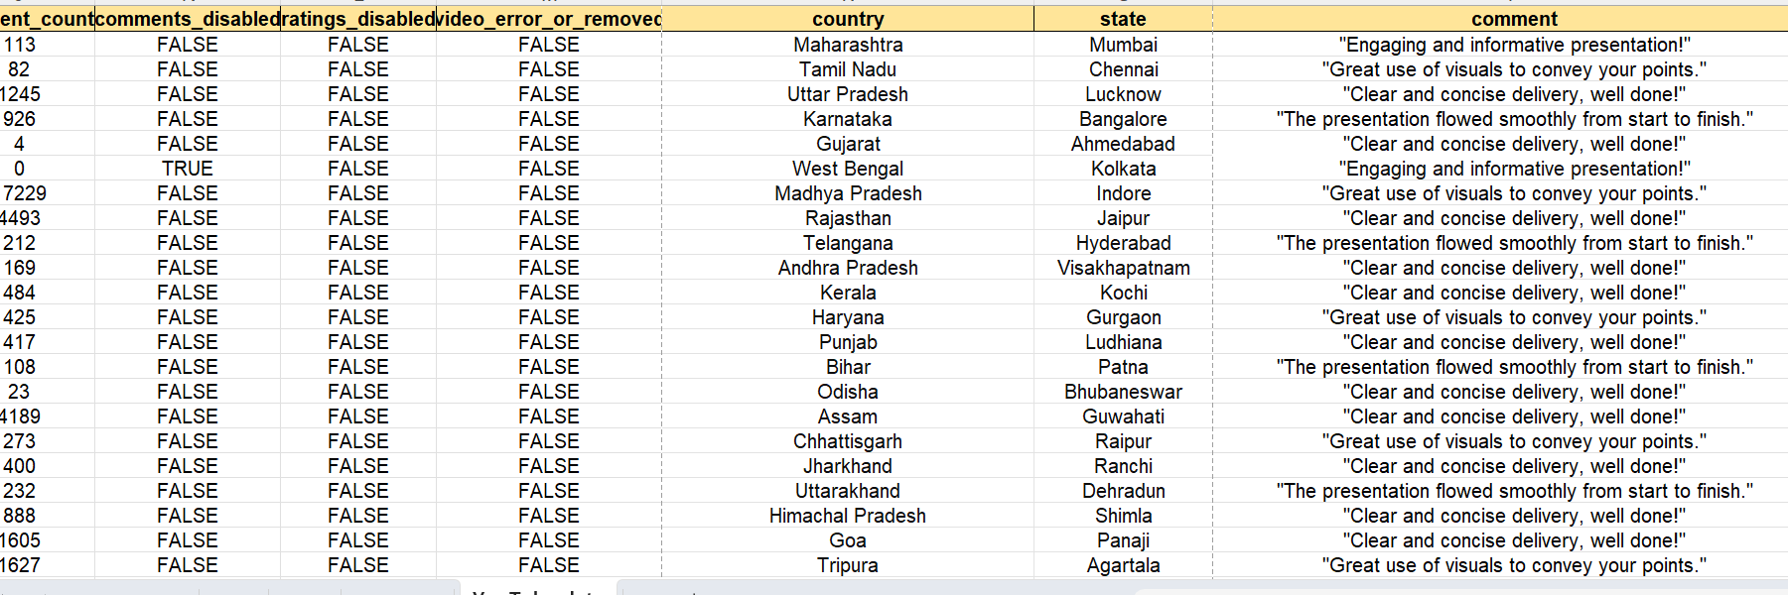
Q1
INFERENCE
Data is cleaned and blanks are filled
FORMULA
=ctrl+a,Ctrl+g,Special,Blanks,=a2,ctrl+enter

Slide 3
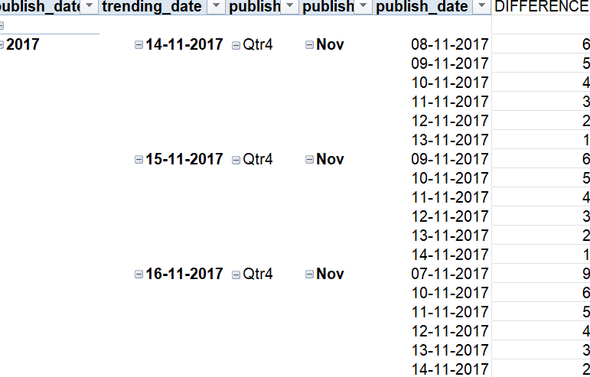
Q2
INFERENCE
THE DIFFERENCE BETWEEN TRENDING AND PUBLISH DATE IS FOUND
FORMULA
=ABS(TRENDINGDATE-PUBLISHDATE)

Slide 4
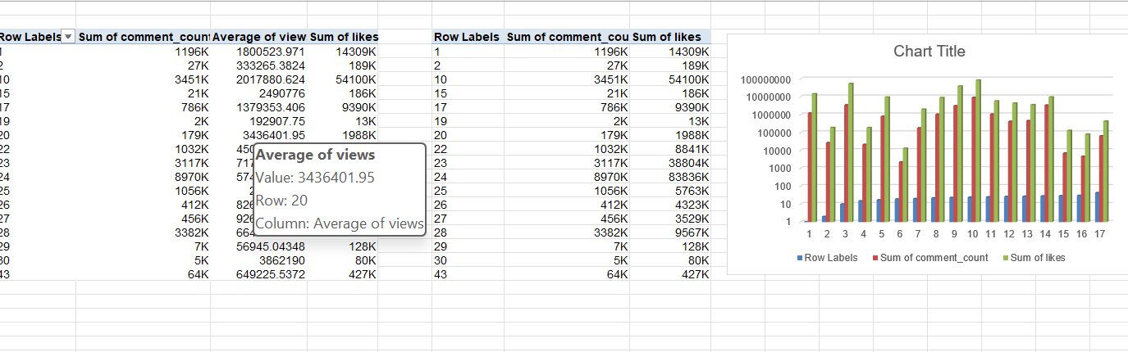
Q3
INFERENCE
THE BAR CHART REPRESENTS COMPARISON OF SUM OF COMMENTS AND LIKES FOR CAT ID
FORMULA
PIVOT TABLE AND CHARTS IS USED

Slide 5
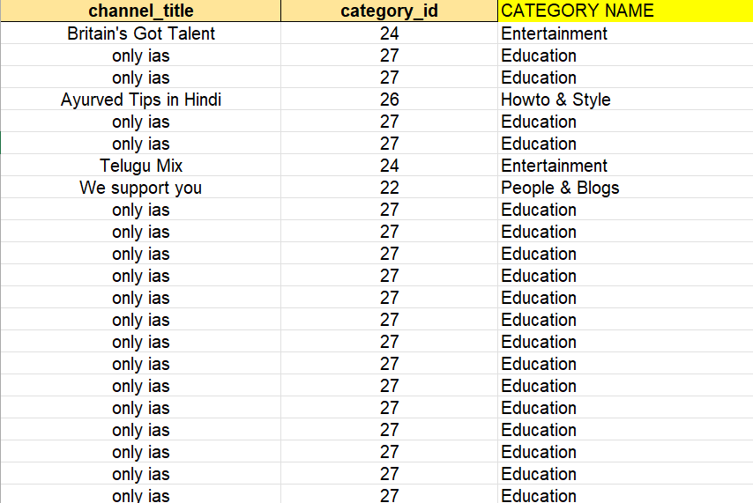
Q4
INFERENCE
CATEGORY NAME IS INSISTED TO THE YOUTUBE DATA USING ID
FORMULA
=XLOOKUP(ID,ARRAY,VALUE,”NA”)

Slide 6
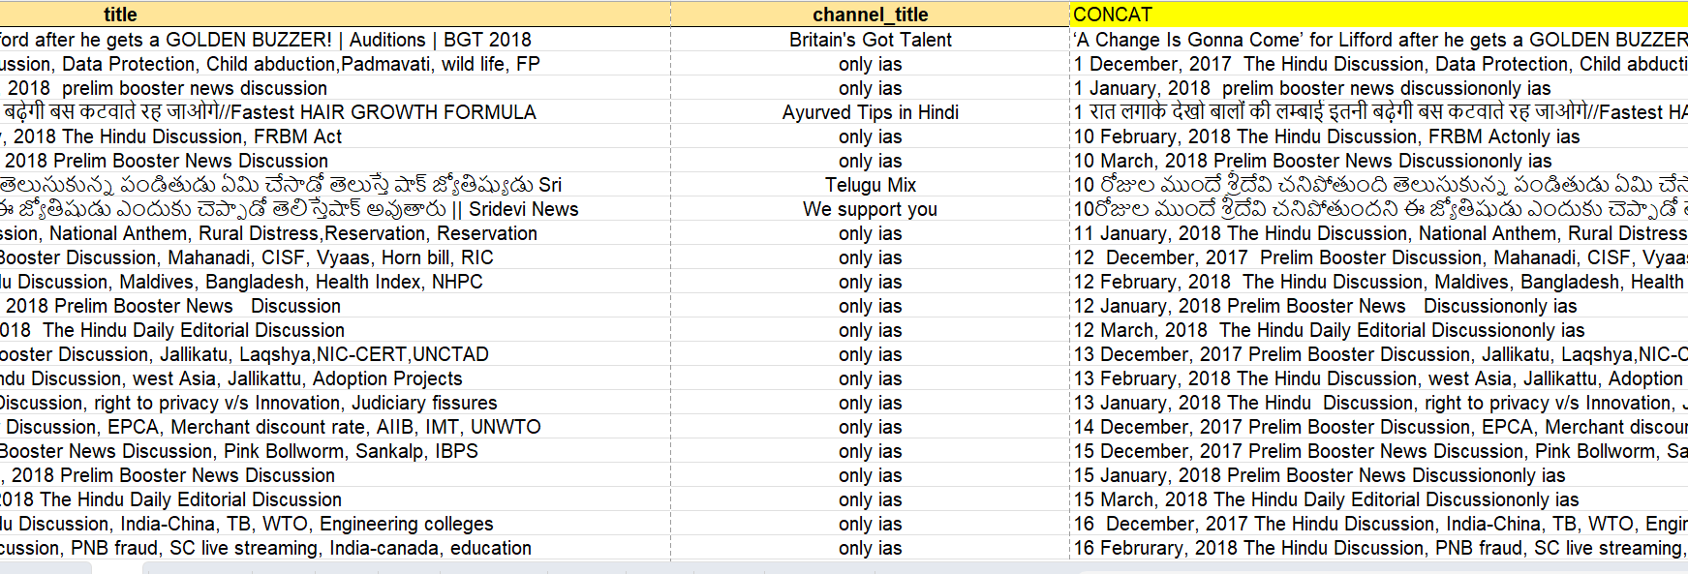
Q5
INFERENCE
CONCATENATION IS DONE.TEXT JOIN IS DONE TO FORM A NEW CATEGORY
FORMULA
=CONCATE(TITLE,CHANNEL TITLE)

Slide 7
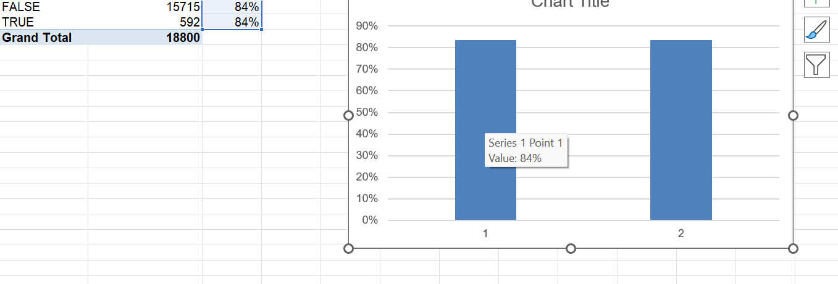
Q6
INFERENCE
TO FIND THE AVERAGE OF FALSE AND TRUE COMMENTS DISABLED
FORMULA
PIVOT TABLE AND BAR CHART
AVERAGE= AVERAGE(VALUE/TOTAL VALUE)

Slide 8
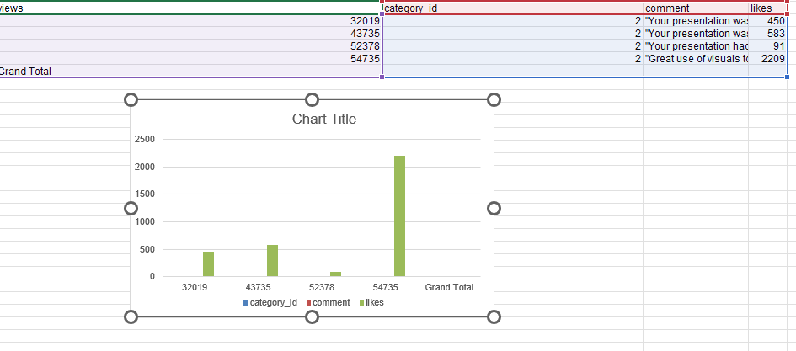
Q7
INFERENCE
VISUAL REPRESENTATION BASED ON LIKES VIEWS AND COMMENTS
FORMULA
PIVOT TABLE IS USED

Slide 9
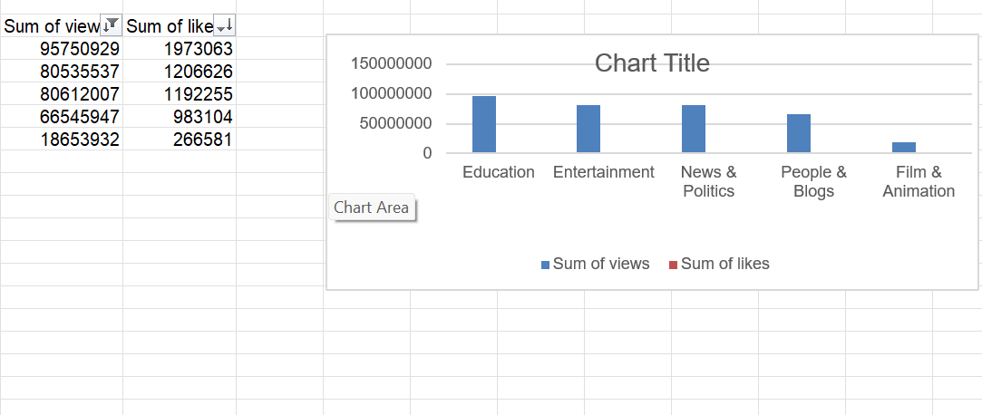
Q8
INFERENCE
TO FIND TOP 5 WITH RESPECT TO SUM OF VIEWS AND SUM OF LIKES BASED ON CATEGORY
FORMULA
PIVOT TABLE AND FILTERATION IS DONE TO SHOW TOP 5

Slide 10
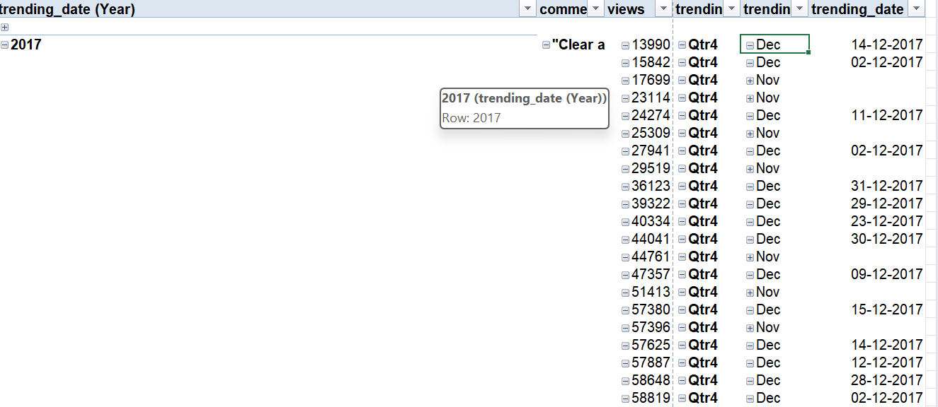
Q9
INFERENCE
FILTER IS APPLIED
FORMULA
PIVOT TABLE IS USED

Slide 11
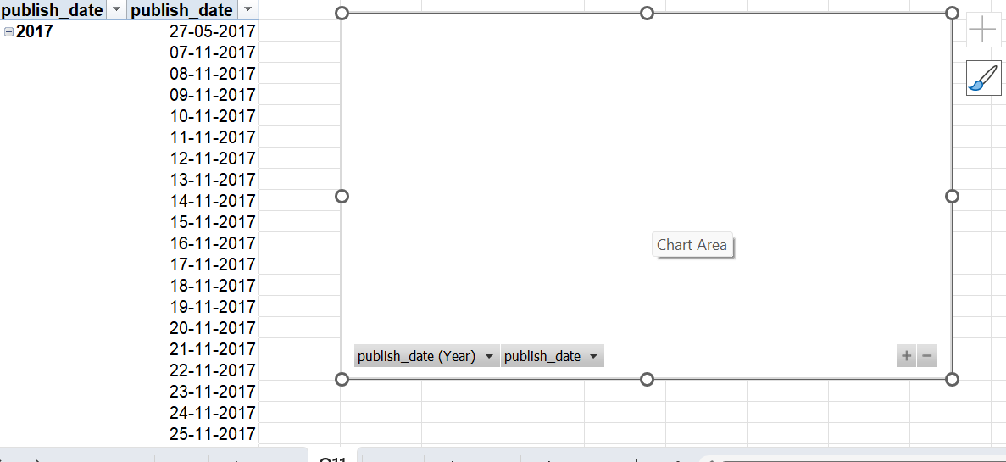
Q10
INFERENCE
GROWTH ANALYSIS IS DONE
FORMULA
PIVOT TABLE

Slide 12
Q11
INFERENCE
FORMULA

Slide 13
Q12
INFERENCE
FORMULA

Slide 14
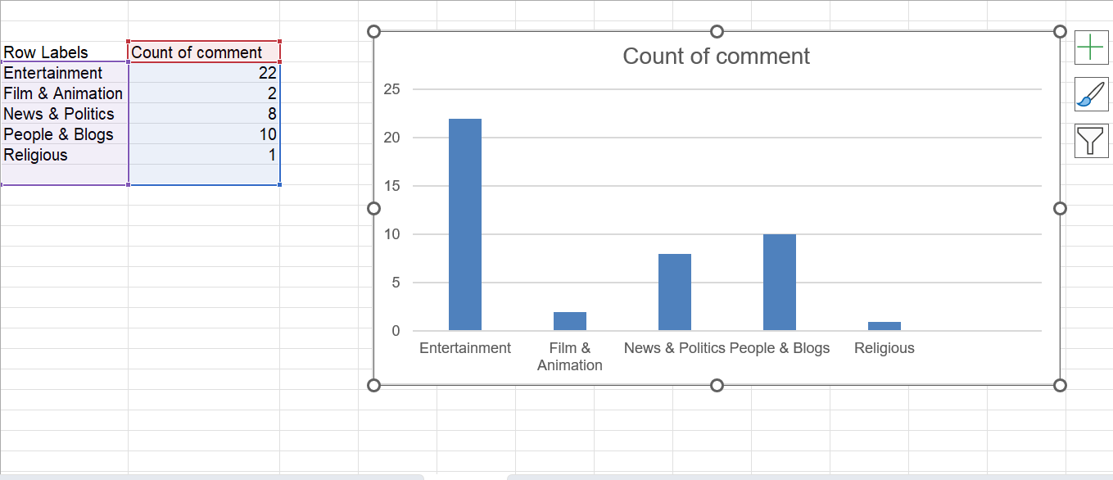
Q13
INFERENCE
FORMULA

Slide 15
Q14
INFERENCE
FORMULA

Slide 16
Q15
INFERENCE
FORMULA

Slide 17
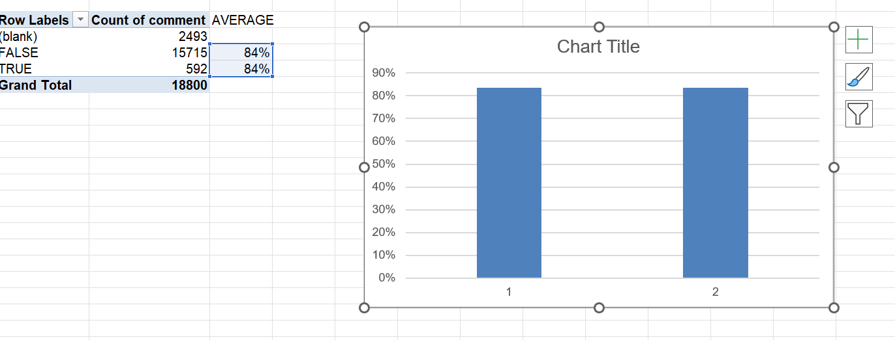
Q16
INFERENCE
FORMULA

Slide 18
Q17
INFERENCE
FORMULA

Slide 19
Q18
INFERENCE
FORMULA

Slide 20
Q19
INFERENCE
FORMULA

Slide 21
Q20
INFERENCE
FORMULA

